Slide 1
Deployment Strategies
Christopher Parnin

Slide 2
Overview

Slide 3
Discussion
How would you create a release strategy?

Slide 4
Release Planning
Parties in charge of environments
Disaster Recovery Plan
Production size and capacity planning
How are defects fixed? Patches applied?
How are upgrades handled? Data migration?
Requirements for logging/monitoring.
Staging to release criteria.

Slide 5
Staging
The process of building confidence in a proposed deployment candidate in the context of a production-like environment.
Can involve a mixture of automated and manual vetting.

Slide 6
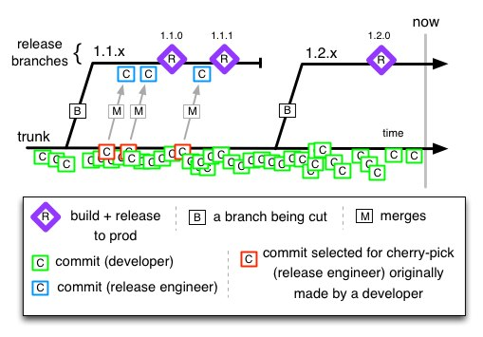
Baking Branches
Release branches created regularly with sprints.
Bake and Test on release branch.
http://paulhammant.com/2013/04/05/what-is-trunk-based-development/

Slide 7
Waterfall Staging
A series of more and more expensive testing performed at each level of staging.
Can be hours or weeks...
Candidate
Simple Testing
Expensive Testing
Dogfood/Beta
Deploy

Slide 8
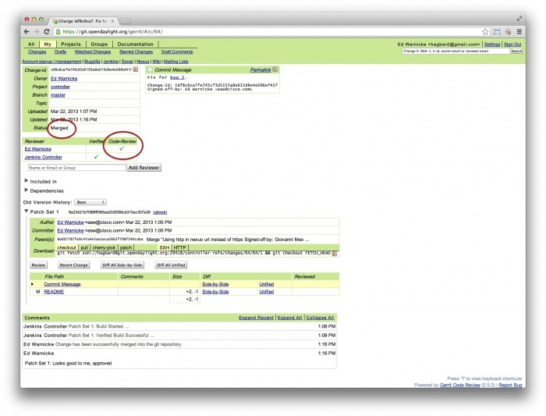
Other activities
User Acceptance Testing
Code Review (Gerrit)

Slide 9
Discussion
How will you deploy now?

Slide 10
Copying Bits
Old school: rsync
git push to hosting end-point (e.g. heroku)
BeanStalk (and service)
Bamboo
Capistrano
Ansible, Salt, Vagrant, GoCD, Chef, Puppet...
https://bintray.com/ (Download service)

Slide 11
Dark Launches
A strategy to release software without any user-facing elements exposed.
Benefits:
Can help eliminate the need to support long-running release branch. Reduces merge issues. Improve disaster recovery.
Read more

Slide 12
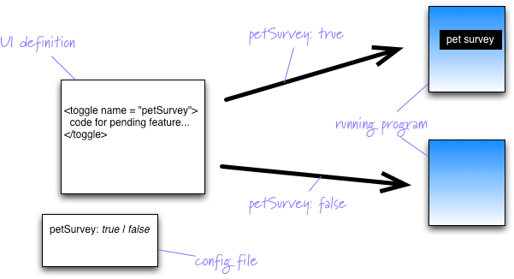
Feature Flags
Typical way to implement a dark launch.
http://swreflections.blogspot.com/2014/08/feature-toggles-are-one-of-worst-kinds.html
http://martinfowler.com/bliki/FeatureToggle.html

Slide 13
Issues
Users might use feature differently than devs expected.
Feature flags are “technical debt”
Company went bankrupt in 45 minutes.
http://dougseven.com/2014/04/17/knightmare-a-devops-cautionary-tale/
Alternative: User Simulation

Slide 14
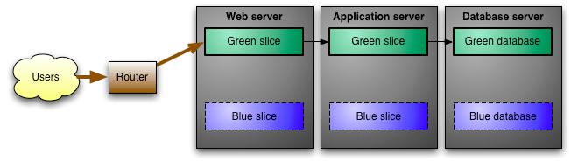
Green/Blue Deployments
Start with two identical infrastructure. Slowly build up second.

Slide 15
Benefits/Issues
Can support “stress-free” deployment and preparation of “blue environment”.
Extra cost in infrastructure overhead.
Data migration issues (switch cost might be high if migration slow and not mirrored).

Slide 16
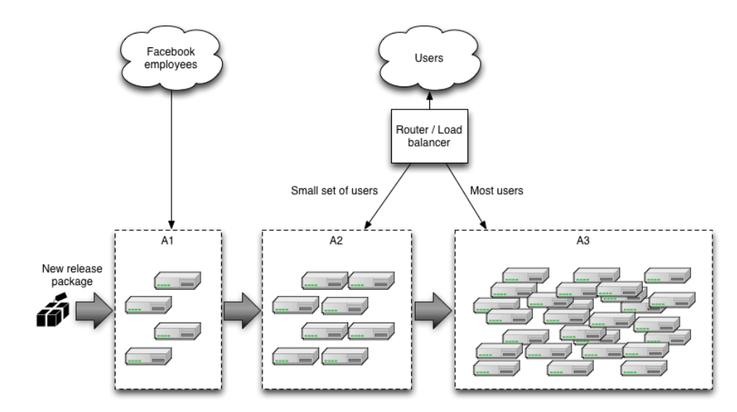
Canary Releasing

Slide 17
Benefits:
Rolling back is easy, stop routing users.
Can combine with A/B testing
Can check if meeting capacity requirements by gradually ramping up load.

Slide 18
Issues:
Deployment to client installed computers.
Any shared resource (cache, services) need to work will all versions in production.
May be supporting multiple versions in production.

Slide 19
Discussion
New Strategy?

Slide 20
Company Practices
Dark launches (FB):
The secret for going from zero to seventy million users overnight is to avoid doing it all in one fell swoop. We chose to simulate the impact of many real users hitting many machines by means of a "dark launch" period in which Facebook pages would make connections to the chat servers, query for presence information and simulate message sends without a single UI element drawn on the page. With the "dark launch" bugs fixed, we hope that you enjoy Facebook Chat now that the UI lights have been turned on.
https://github.com/CSC-DevOps/Course/blob/master/Readings/Deployment.md

Slide 21
Project Discussion

